Slide 1
KENYA DIGITAL ID MANAGEMENT SYSTEM
SCI 400 : Research Project Final Report
Name : Kelvin Alianda| REG. Num: 1046089
Supervisor: Mr. Isaac Tonui

Slide 2
Content
Background of the Research
Problem Statement
Main & Specific Objectives
Analysis
Design
Implementation

Slide 3
Background of the Research
Digital Identity Management in Kenya
Kenya's transition from manual to digital ID systems
Need for efficient, secure, and accessible ID management
Government initiatives towards digital transformation
Current ID Management Challenges
Long processing times for ID applications
Lack of real-time tracking capabilities
Manual verification processes prone to errors
Limited accessibility for citizens in remote areas
Security vulnerabilities in traditional systems
Technological Context
Rise of web-based government services
Increasing smartphone and internet penetration in Kenya
Digital-first approach to public service delivery

Slide 4
Problem Statement
The current Kenya ID management system faces significant challenges including:
• Inefficient Processing: Manual application processing leads to delays of weeks or months
• Poor Transparency: Citizens cannot track their application status in real-time
• Security Concerns: Paper-based systems vulnerable to fraud and data breaches
• Limited Accessibility: Physical presence required at registration centers • Administrative Burden: High workload on government officers with manual processes
• Poor Record Management: Difficulty in maintaining accurate, up-to-date records
Research Question: How can a digital web-based system improve the efficiency, transparency, and security of Kenya's ID management process?

Slide 5
Main & Specific Objectives
Main Objective
To design and develop a comprehensive digital ID management system that streamlines the ID application, processing, and tracking processes for Kenya.
Specific Objectives
Develop a multi-portal system supporting different user types (Citizens, Officers, Administrators)
Implement real-time application tracking allowing citizens to monitor their ID status
Create secure authentication mechanisms for officers and administrators
Design an efficient workflow system for ID application processing
Integrate payment processing for ID-related services
Establish comprehensive reporting capabilities for administrative oversight
Ensure responsive design for accessibility across different devices

Slide 6
Requirements Analysis
Functional Requirements
User Authentication: Secure login for officers and administrators
Application Management: Create, update, and process ID applications
Status Tracking: Real-time application status updates
Payment Processing: Handle fees for ID services
Document Management: Upload and manage application documents
Reporting: Generate reports on applications and system usage
Lost ID Replacement: Manage lost/damaged ID replacement process
Multi-role Support: Different interfaces for different user types
Non-functional Requirements
Security: Data encryption, secure authentication, role-based access.
Performance: Fast response times, efficient database queries.
Scalability: Handle increasing number of users and applications.
Usability: Intuitive user interface, responsive design.
Reliability: 99% uptime, data backup and recovery.
Compliance: Adherence to Kenya's data protection regulations

Slide 7
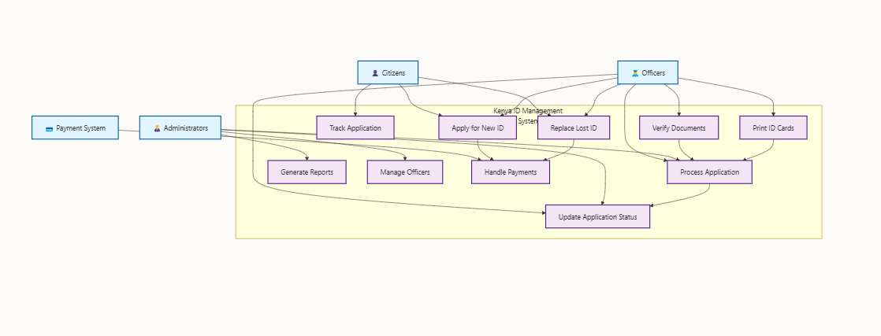
System Analysis

Slide 8
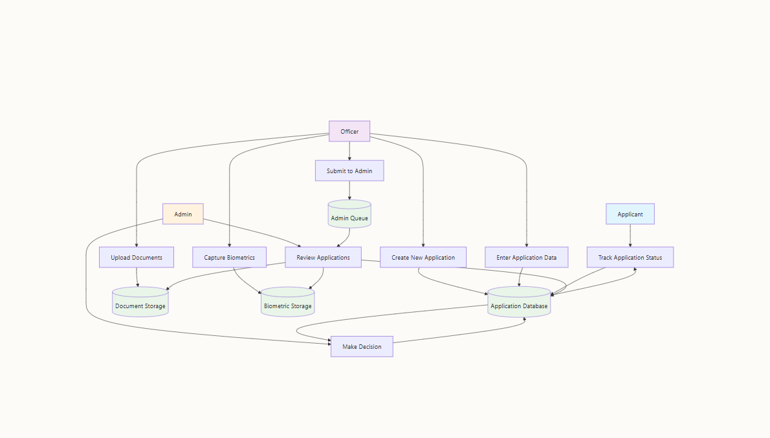
Data Flow Diagram (Level 1)

Slide 9
System Components
System Users/Actors:
Citizens: Apply for IDs, track applications, make payments.
Registration Officers: Process applications, verify documents, update status.
System Administrators: Manage officers, generate reports, system oversight.
Payment Gateway: Process payments for ID services.
System Input/Input Forms
New ID Application Form: Personal details, documents, photos.
Officer Login Form: Authentication credentials.
Admin Login Form: Administrative credentials.
Lost ID Replacement Form: Personal verification, reason for replacement.
Payment Form: Payment details and processing.
Application Tracking Form: Application reference number

Slide 10
System Components Cont’d
System Output/Reports
Application Status Reports: Current status and processing stage.
Administrative Dashboard: System statistics and metrics.
ID Generation Reports: Completed applications and issued IDs.
System Entities
Application: ID application records.
User: System users (citizens, officers, admins).
Officer: Registration officer details.
Payment: Transaction records.
Document: Uploaded application documents.
Status: Application status tracking.

Slide 11
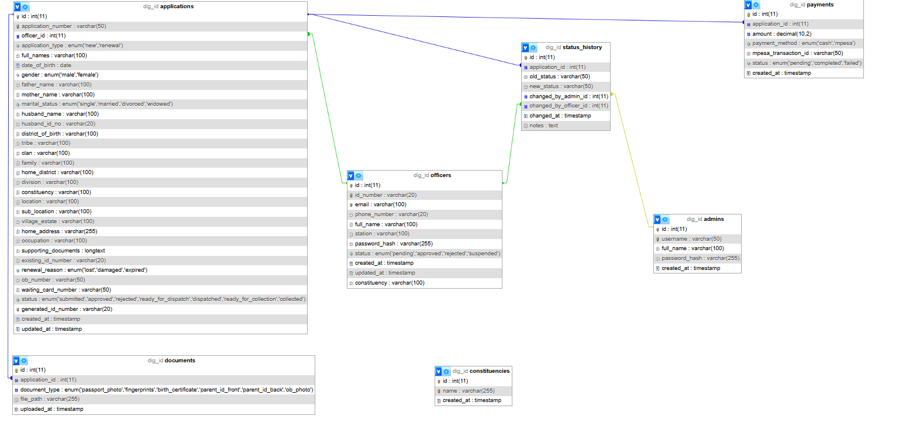
Database Design (ERD)

Slide 12
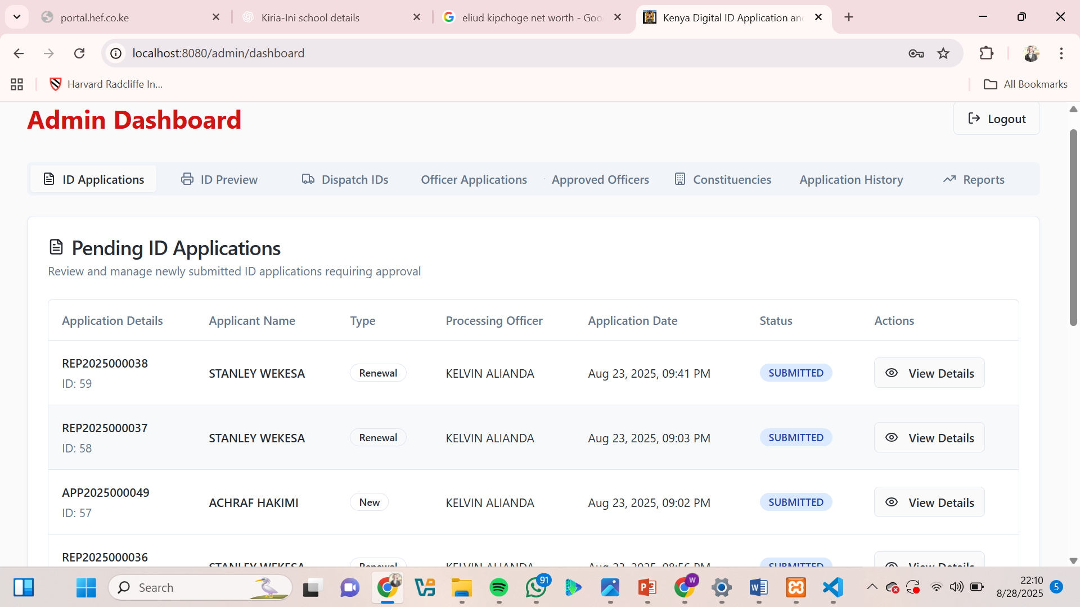
Sample Test Data

Slide 13
Implementation
Technology Stack & Implementation
Frontend Development: HTML, CSS, and JavaScript,Built responsive web interface using React with TypeScript.
Backend Development: Python (Flask).
Database Implementation: MySQL Database.
User Authentication: Implemented Secure Login System with Role-Based Access Control.
Form Validation: Added client-side and server-side validation for data integrity

Slide 14
Conclusions
The Kenya Digital ID Management System successfully addresses the identified challenges in the current ID management process by providing:
Efficient Digital Workflows reducing processing time from weeks to days.
Real-time Transparency allowing citizens to track applications instantly Enhanced Security through role-based access and data encryption.
Improved Accessibility via responsive web-based interface.
Comprehensive Administration with detailed reporting and officer management.
The system demonstrates significant improvements in efficiency, security, and user experience while maintaining compliance with government standards and regulations.

Slide 15
THE END
Thank you for your attention. I welcome any questions about the Kenya Digital ID Management System.

